Slide 1

CUSTOMER RELATIONSHIP MANAGEMENT ANALYSIS
Presented By:-
Pratima Surve

Slide 2
ABOUT THE PROJECT
The dataset consists of multiple files related to sales, customers, interactions, leads, and tickets, each containing important business data. The sales data includes details like sale date, product ID, customer ID, sales amount, and quantity sold. The customer data provides information about customer ID, name, city, country, and the date they joined. The interactions data tracks customer communication through emails, calls, and chats. The leads data contains potential customer details, lead sources, and their status. Lastly, the tickets data records customer complaints, issue types, and resolution details. This dataset helps in analyzing customer behavior, sales trends, and service issues for better decision-making.

Slide 3
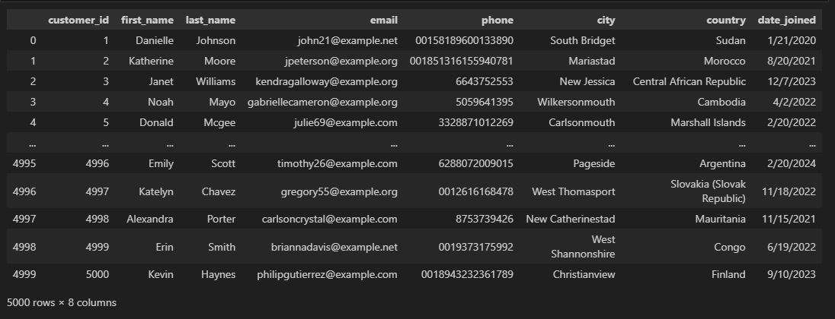
Customers_large

Slide 4
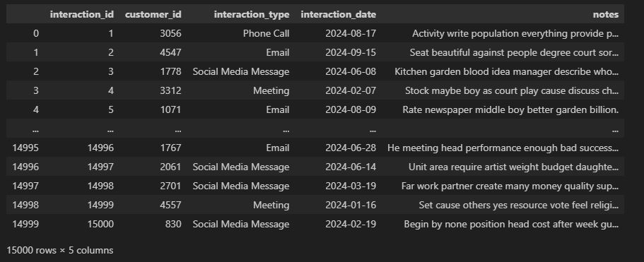
Interactions_large

Slide 5
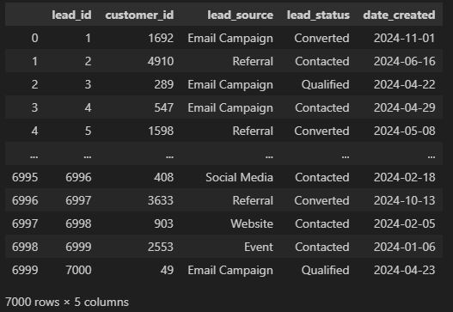
Leads_large

Slide 6
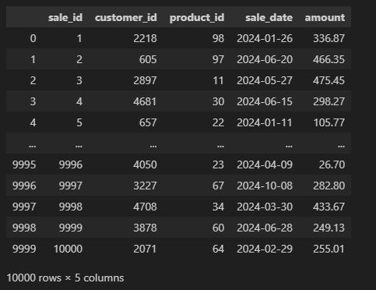
Sales_large

Slide 7
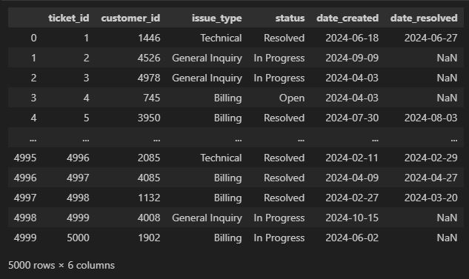
Tickets_large

Slide 8
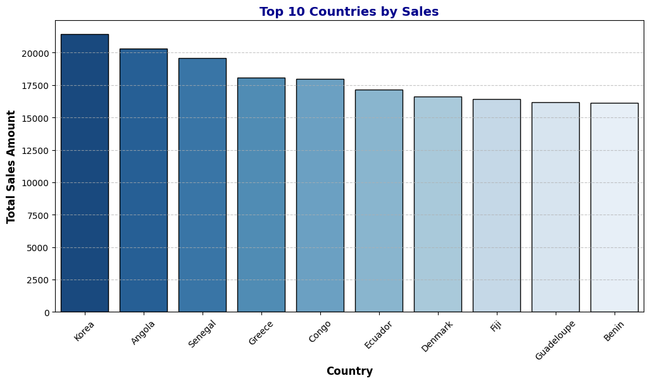
Question 1:- How do sales change in different countries, products, and cities, and how can this help a business grow?
Graph 1:-Top 10 Countries by Sales
Observation:- Korea leads in sales, followed by Angola and Senegal. The top 10 countries contribute greatly, but sales vary among them.

Slide 9
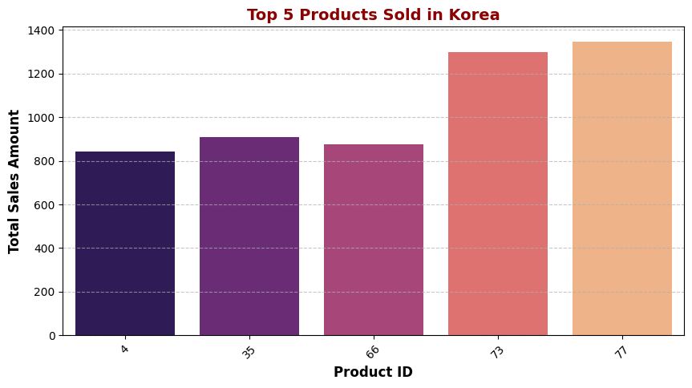
Graph 2:- Top 5 Products Sold in Korea
Observation :- Products 73 and 77 are top sellers in Korea, while 4, 35, and 66 have moderate sales.

Slide 10
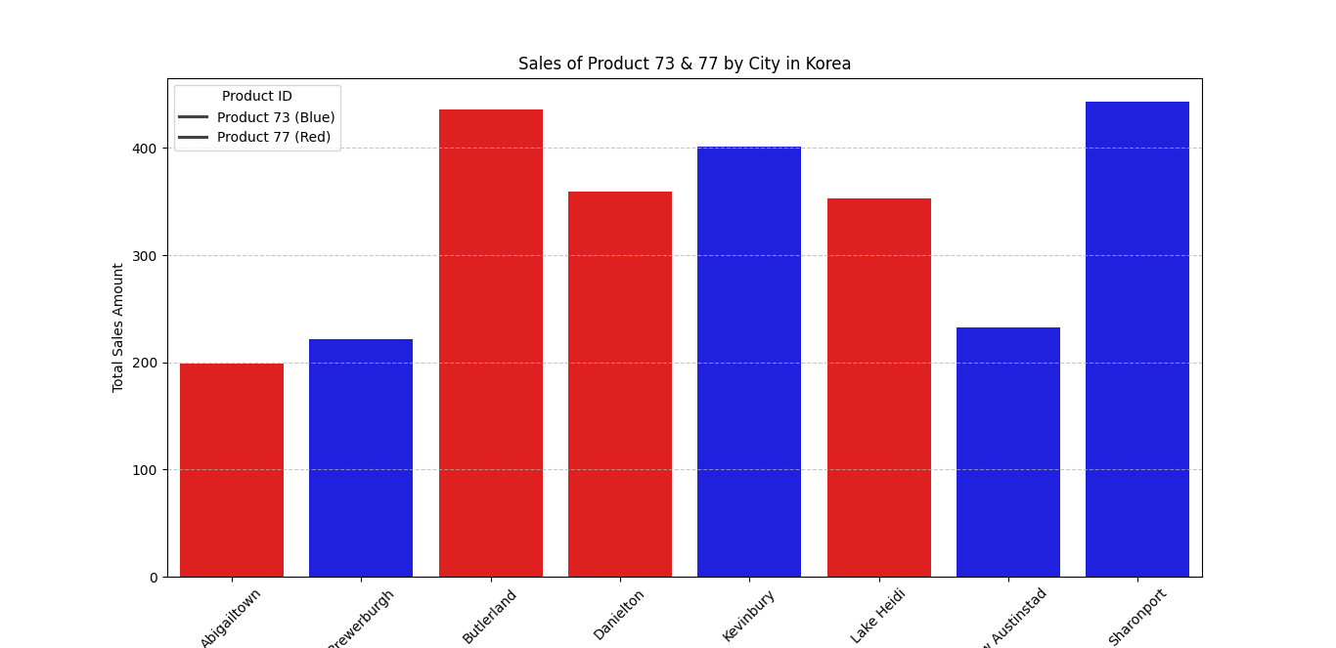
Graph 3:- Sales of Product 73 & 77 by City in Korea
Observation:- Cities prefer different products: Butterland and Danielton favor 77, while Kevinbury and Sharonport favor 73. Some cities have balanced sales.

Slide 11
Conclusion
Korea is a key sales hub, with Products 73 and 77 being the most popular. Different cities prefer different products, so targeted marketing can improve sales and profits.

Slide 12
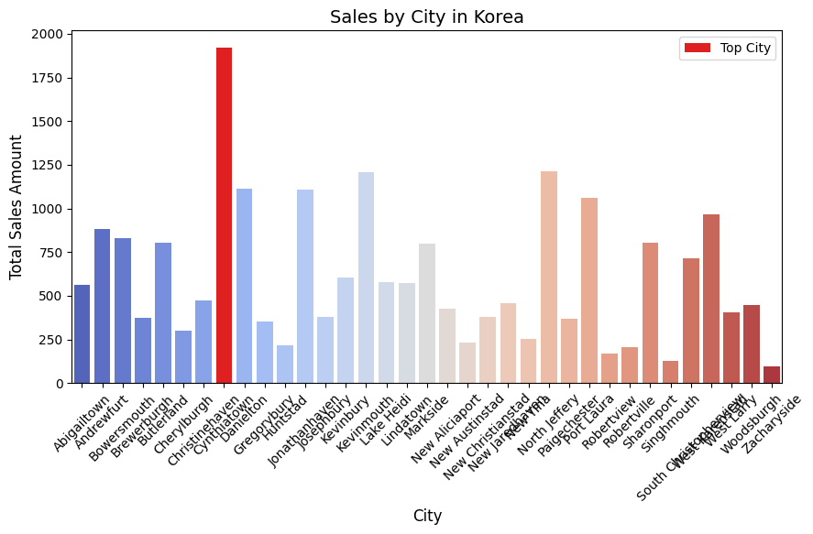
Question 2:- Which cities, products, and customers contribute the most to overall sales, and how can this information be used to optimize sales strategies?
Graph 1:- Sales by City in Korea
Observation:-Cynthiatown dominates sales, while low-sales cities offer expansion potential.

Slide 13
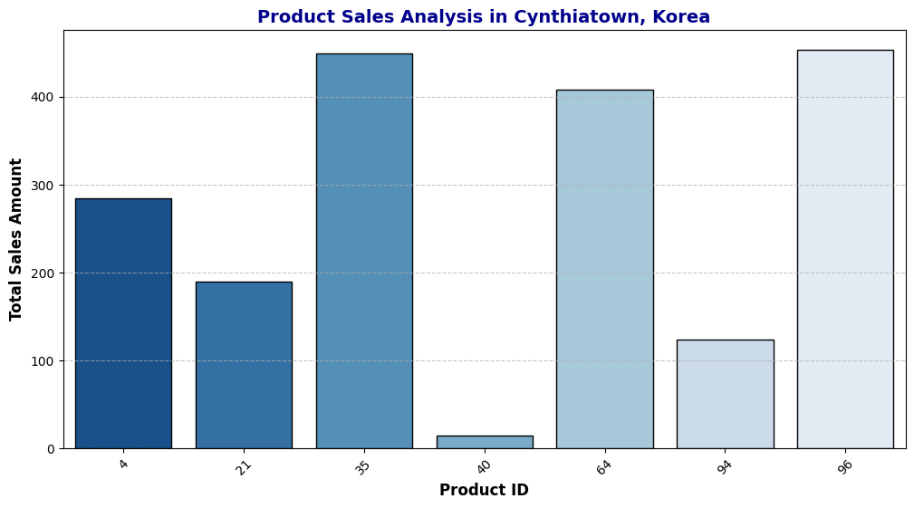
Graph 2:-Product Sales in Cynthiatown:
Observation:-Products 35, 64, and 96 lead in sales, while 40 lags, indicating uneven demand and a need for analysis.

Slide 14
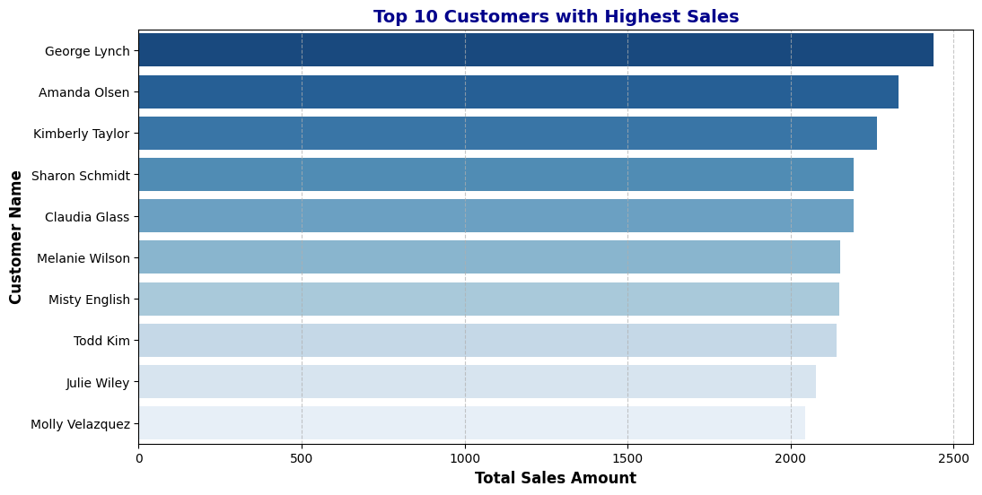
Graph 3:- Top 10 Customers with Highest Sales:
Observation:- George Lynch, Amanda Olsen, and Kimberly Taylor are top spenders, with a few customers driving major sales.

Slide 15
Conclusion
Cynthiatown leads in sales, key products drive revenue, and a few top customers contribute significantly. Businesses should focus on high-performing locations, optimize inventory, and strengthen customer loyalty programs.

Slide 16
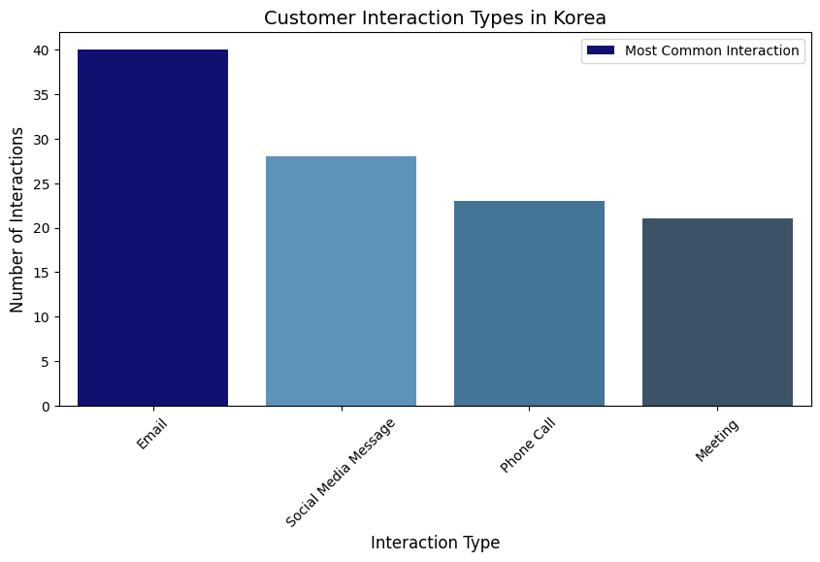
Question 3:-What are the top 10 most purchased products in Korea, and how do customer interaction types correlate with the most common ticket issues reported?
Graph 1:- Find Most Common interaction type in Korea
Observation:- From this graph we find out the most common interaction type in Korea in E-mail

Slide 17
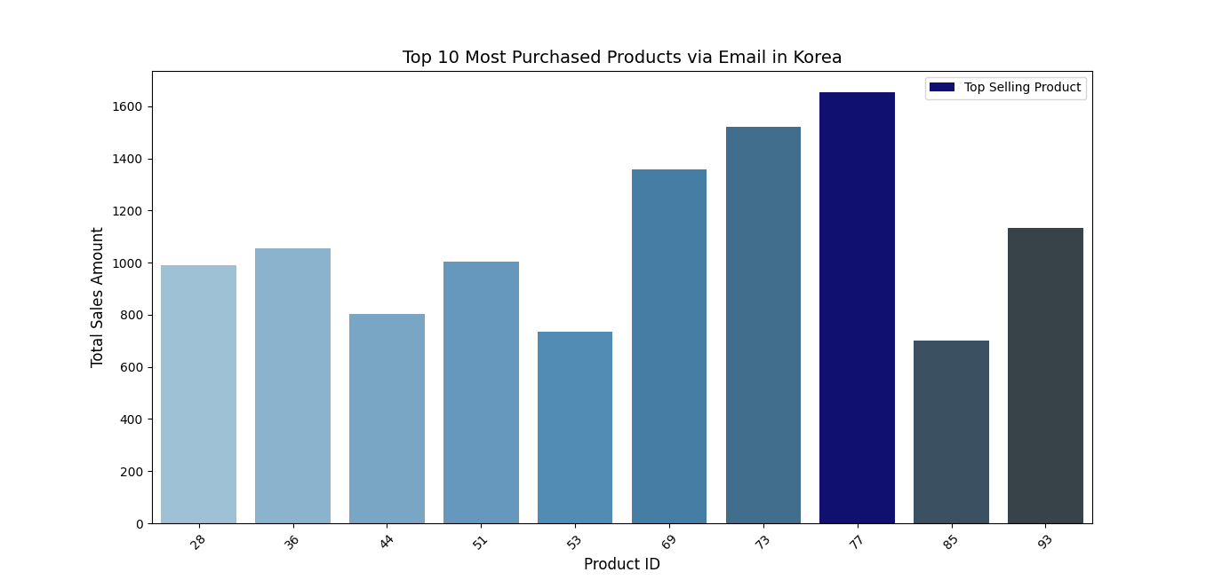
Graph 2 :-From E-mail interaction which products are sales is high
Observation:- From Above Graph in Korea from E-mail interaction 77 product is high sales , Second is 73 product is high sales

Slide 18
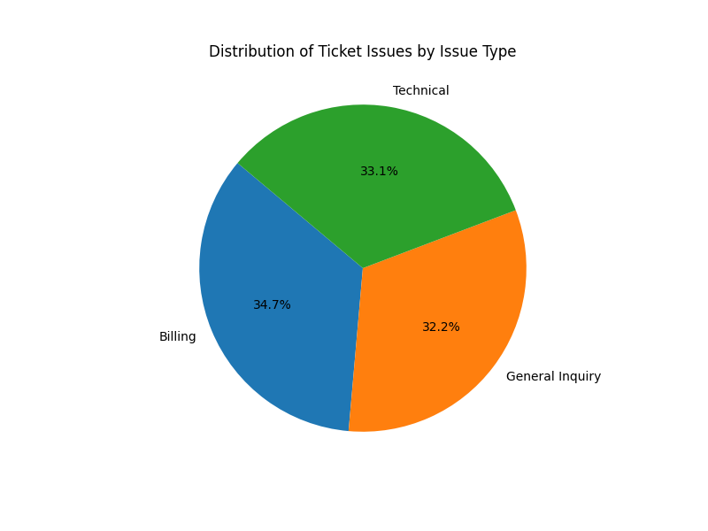
Graph 3:- Total Issue Type In Korea
Observation:- From observation we can find In Billing has a high ticket issue in Korea

Slide 19
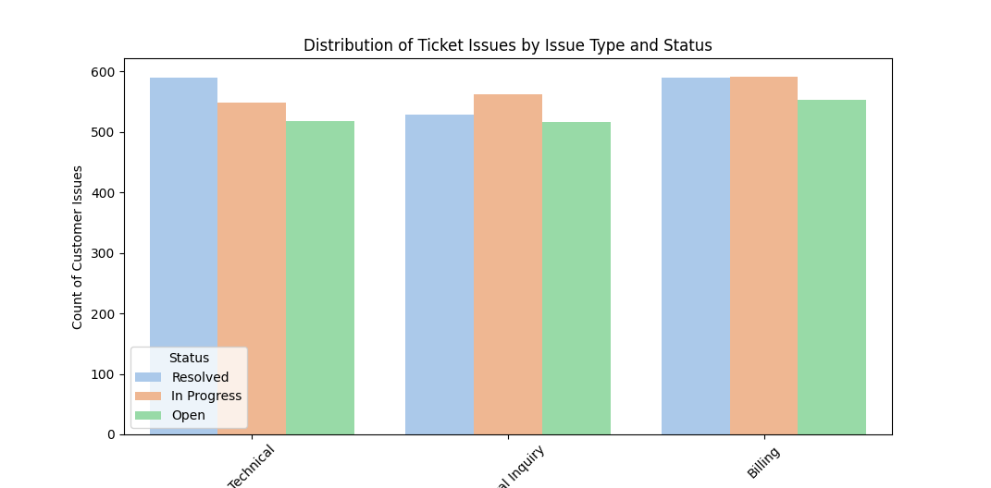
Graph 4:- Ticket Status Distribution by Issue Type
Observation:- From above graph there is a Resolved Ticked Status In that Billing,General inquiry & Technical is More Preffered

Slide 20
Conclusion
E-mail is the most common interaction type in Korea, driving the highest sales (77 and 73 units). Billing has the highest ticket issues, but it, along with General Inquiry and Technical Support, sees more resolutions. Optimizing E-mail interactions and improving Billing support can enhance customer satisfaction and sales efficiency

Slide 21
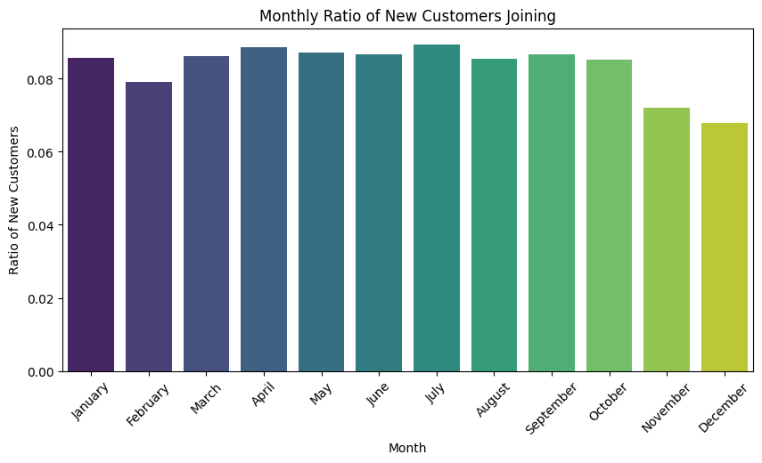
Question 4 :- In Which Month New Customers Join More and Why?
Graph 1 :- Monthly ration of New Customer Joining
Observation:- There are in July month new customers are join more

Slide 22
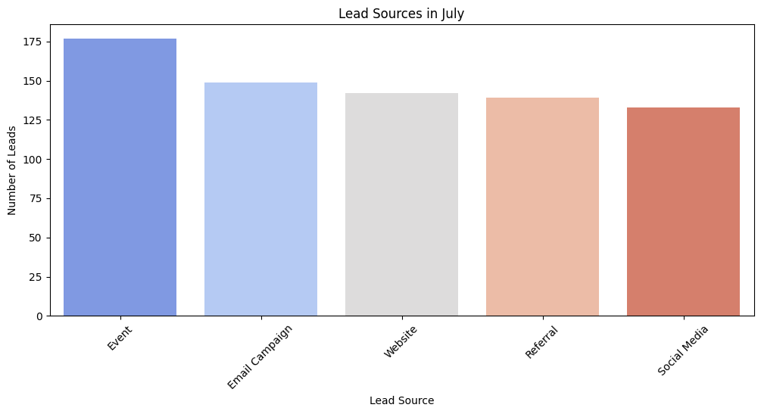
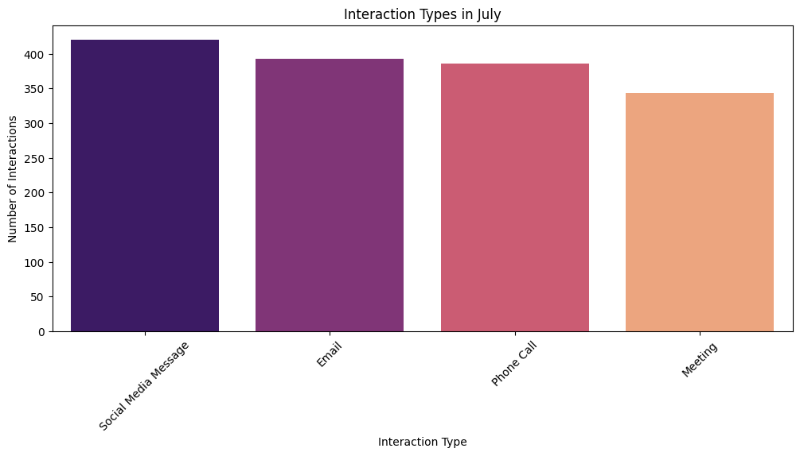
Justification Of Why In July Month New Customers Join highly
Graph 2 & 3

Slide 23
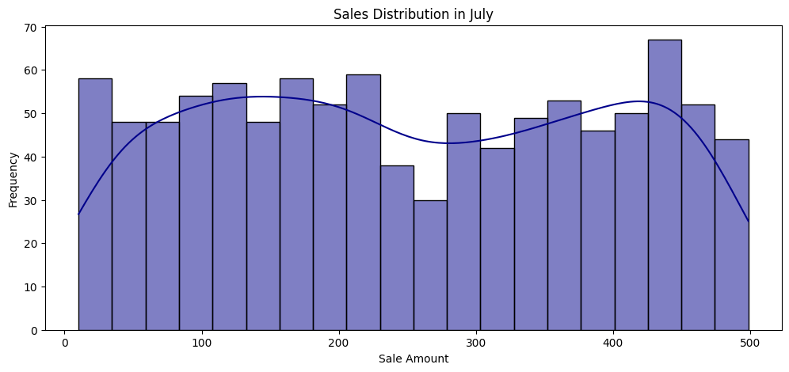
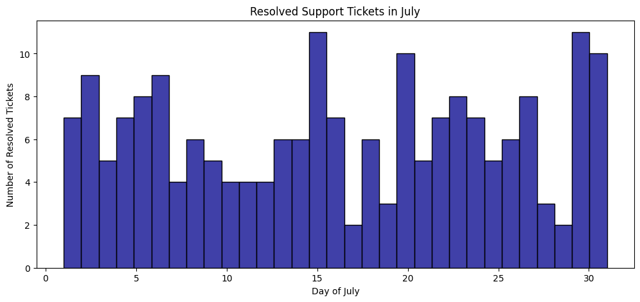
Graph 4 & 5
Conclusion:- Because of all this justification we can see there in July has more new costomers are joined,It helps to grow sales and profit

Slide 24
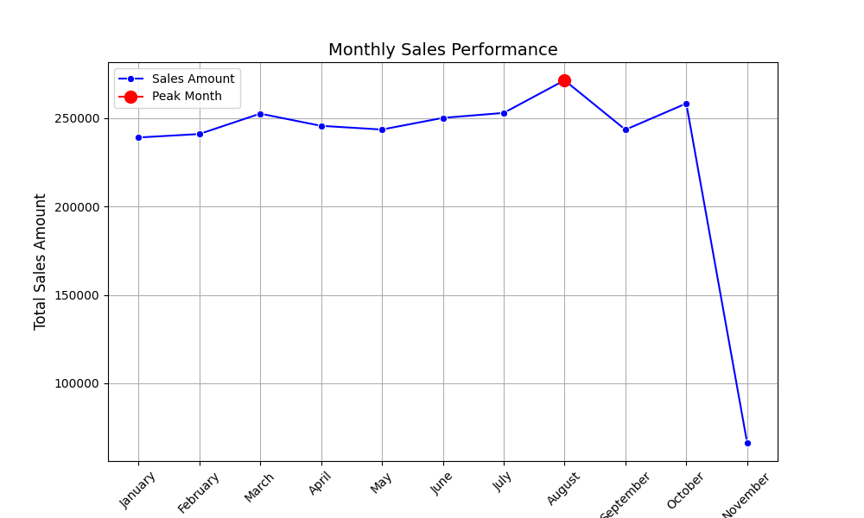
Question 5:- In which month are sales highest, and how do monthly sales trends correlate with the daily rate of new customer sign-ups?
Graph 1:- Find In which month sales are peaked up
Observation:- After that observation we can find in August sales are peaked up

Slide 25
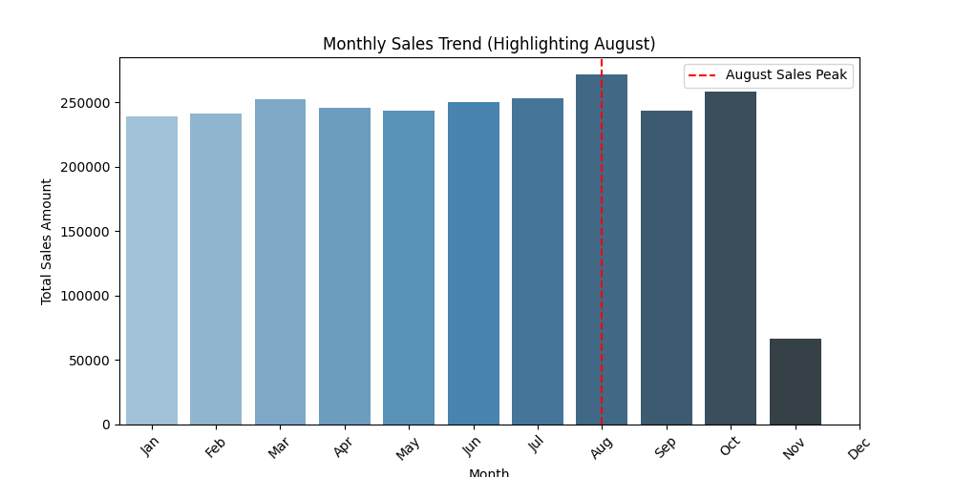
Graph 2:- Highlight Monthly Sales Trend
Observation:- In that Sales Trend August Month Highlighting Because Of Sales

Slide 26
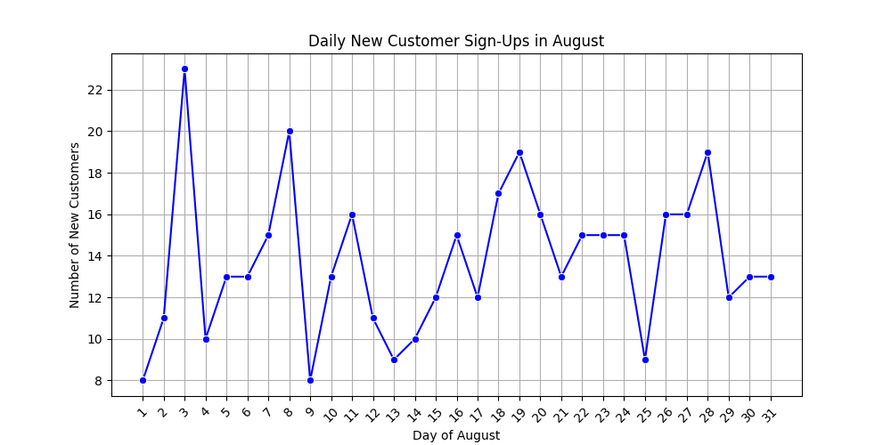
Graph 3:-How Many Daily New Customers Sign-Ups In August
Observation:-There are In 3 August highest new customers are sign-Ups

Slide 27
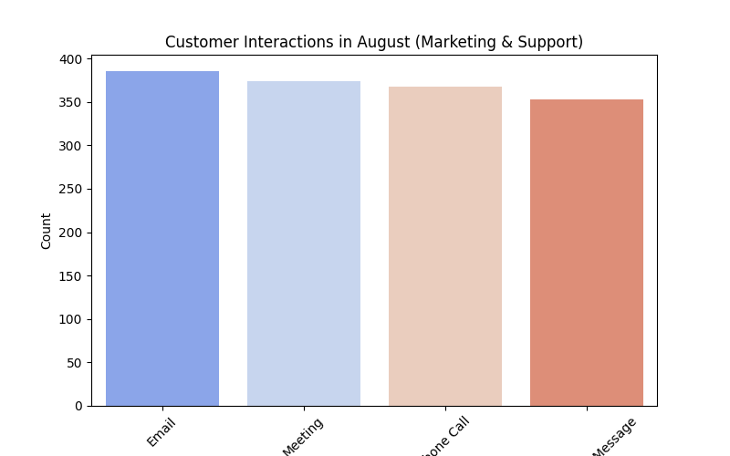
Graph 4:-In August Customer Interaction
Observations:-In this graph E-mail is high interaction Type in August

Slide 28
Conclusion
August saw peak sales, with August 3rd having the highest new customer sign-ups. E-mail was the most preferred interaction, driving both sales and customer acquisition, emphasizing its role in future growth strategies.

Slide 29
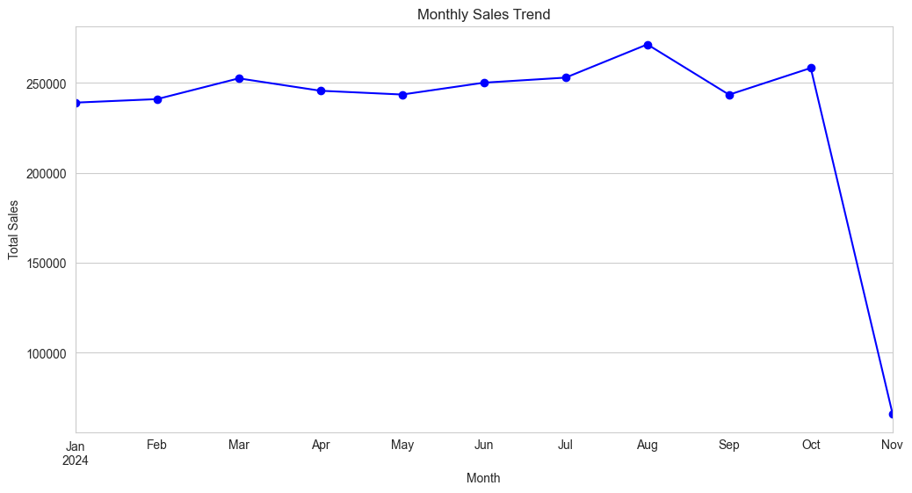
Question 6 :-In which month did sales decline the most, and how does the monthly sales drop correlate with Customers who stop Purchasing & daily customer interactions during that period?
Graph 1 In which month sales are drop highly
Observation:- There are From September to November are sales are drop highly

Slide 30
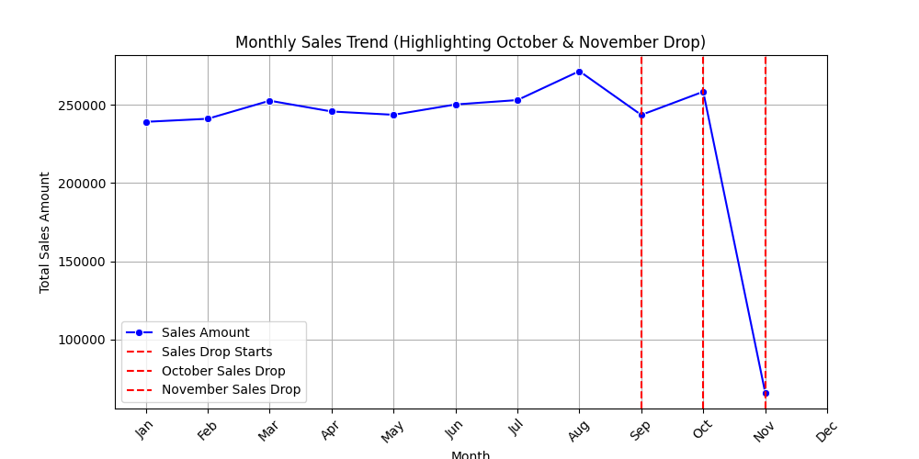
Graph 2:- In Which months sales trend drop
Observation:-In that from sep,oct,nov,months are drop sales highly

Slide 31
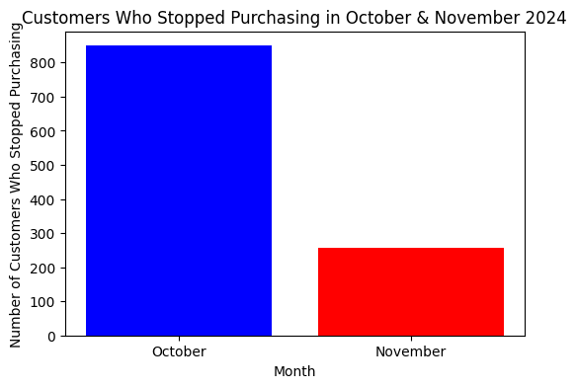
Graph 3:- Customers who stop purchasing in this months
Observations:- In the purchasing rate in month oct & nov highly fluctuated in oct month

Slide 32
Conclusion
The sales trend remained stable until August 2024, followed by a decline in September and a sharp drop in November. The highlighted graph confirms that the decline started in October, leading to a major fall in November. The last graph shows that many customers stopped purchasing in October, with fewer in November, indicating a possible reason for the sales drop. This suggests an issue affecting customer retention that needs further investigation.

Slide 33
CONCLUSION
The CRM analysis shows steady sales growth until mid-2024, followed by a sharp decline in October-November, likely due to seasonal trends or competition.
Many customers stopped purchasing, indicating possible dissatisfaction or pricing issues.
Email Campaigns and Referrals generated the most leads, while Social Media provided stable growth. Event-based leads were unpredictable. Businesses should invest in Email Campaigns and Social Media while being cautious with event-based marketing.To improve performance, businesses should analyze sales decline causes, strengthen customer retention, and enhance customer service for better satisfaction and loyalty.

